Slide 3
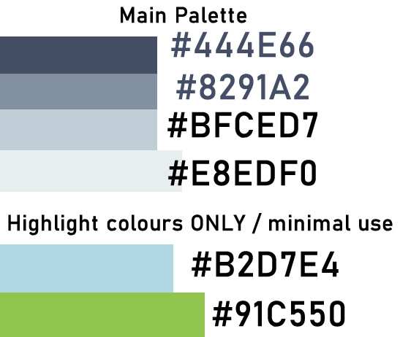
Main big heading
Sub heading
General text This handy tool helps you create dummy text for all your layout needs. We are gradually adding new functionality and we welcome you’re a text highlight suggestions and feedback. Please feel free to send us any additional dummy texts.

